Slide 1
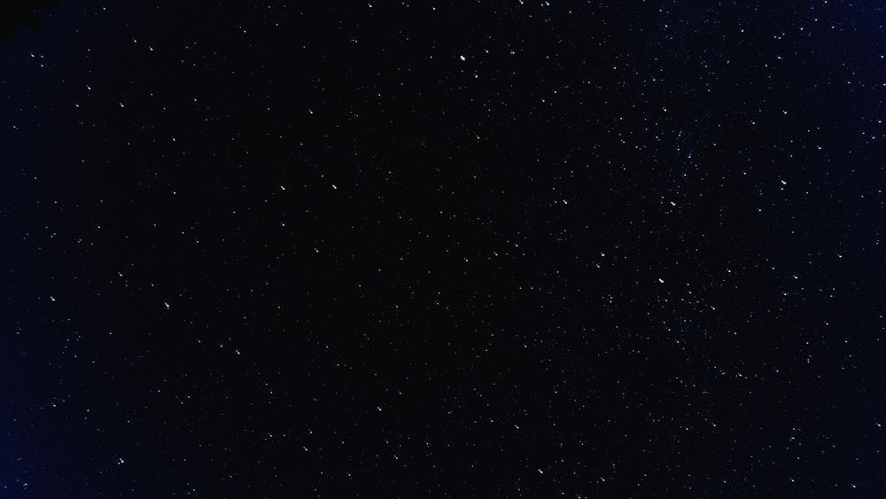

Social Media Growth in Astronomy
Tyler Woods

Slide 2
Problem
Current Generation on Social Media
  50 Milliseconds
    Lindgaard et. al, 2011
  Attention

Slide 3
Question
How do you create a successful social media account and website for science information and news, and captivate the public?
Notes:
Public- mainly those who are active online and on social media (younger gen)

Slide 4

Goals
Create an engaging, easy to use Website.
2) Sustain a compelling Social Media account.
3) Find the best recipe for max engagement.
Notes:
Provide further details into project and make it easy for those who want to learn more
Make information interesting to viewers and digestible for all levels of astronomy knowledge
schedule, alternating captivating infographics and videos, utilizing hashtags, and posting at optimal times to maximize traction

Slide 5
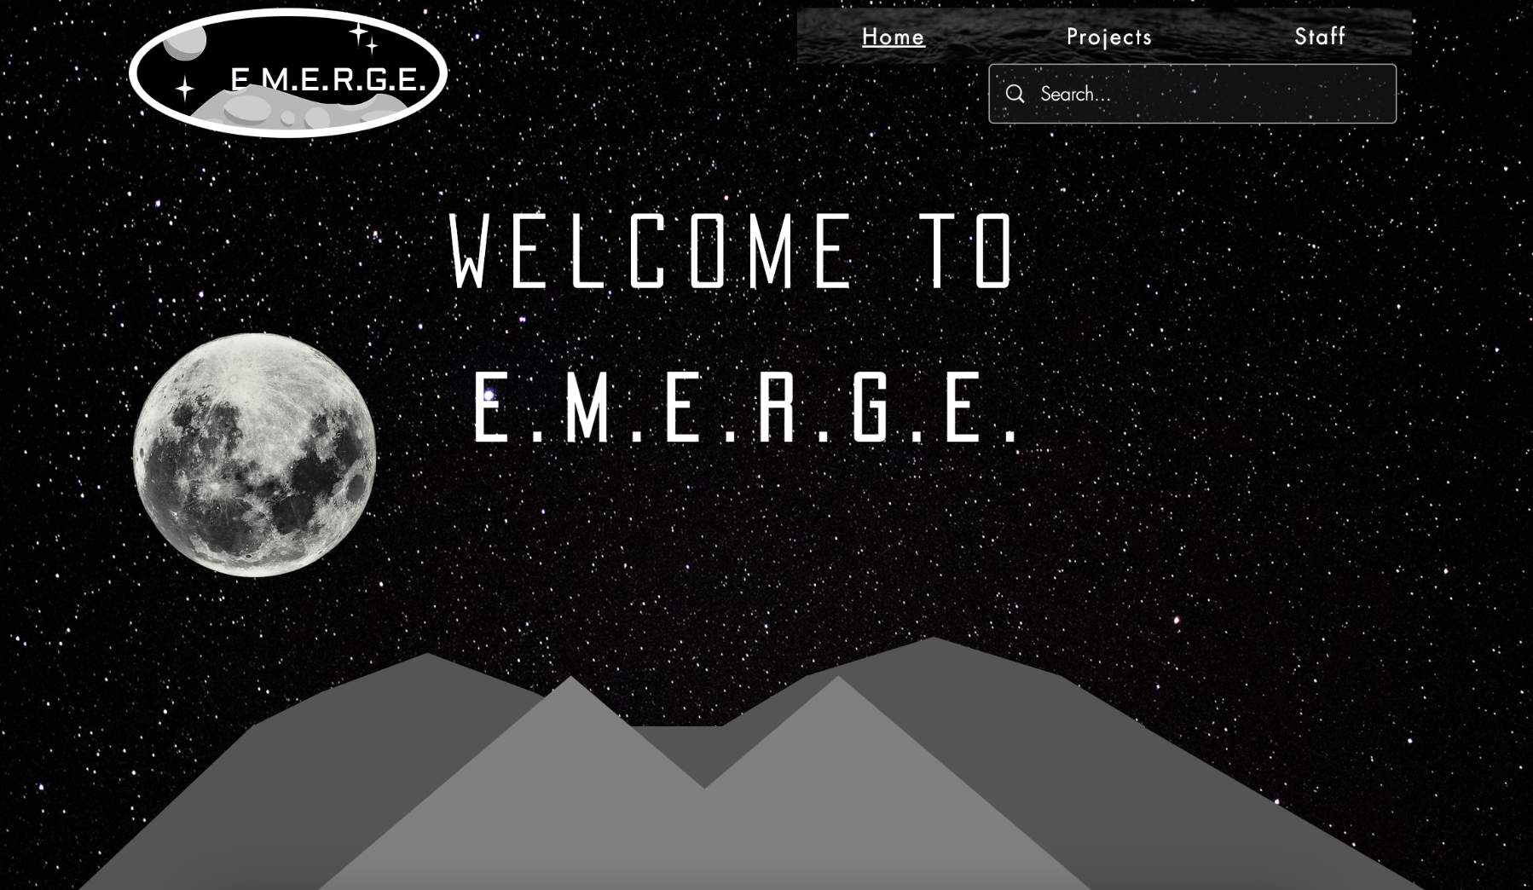
Website
Notes:
Beginning the website
San Fransisco Mountains

Slide 6
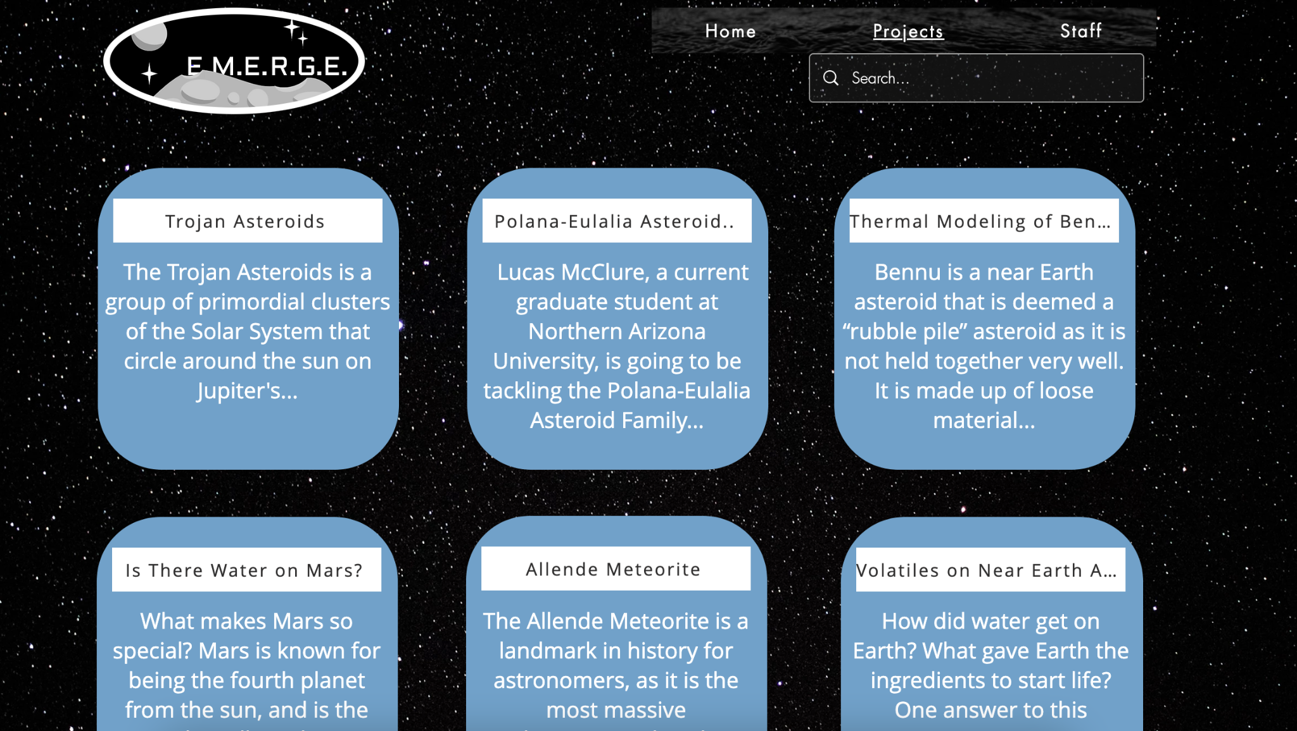
Website
Notes:
Beginning the website
Interviewing current students on Projects

Slide 7
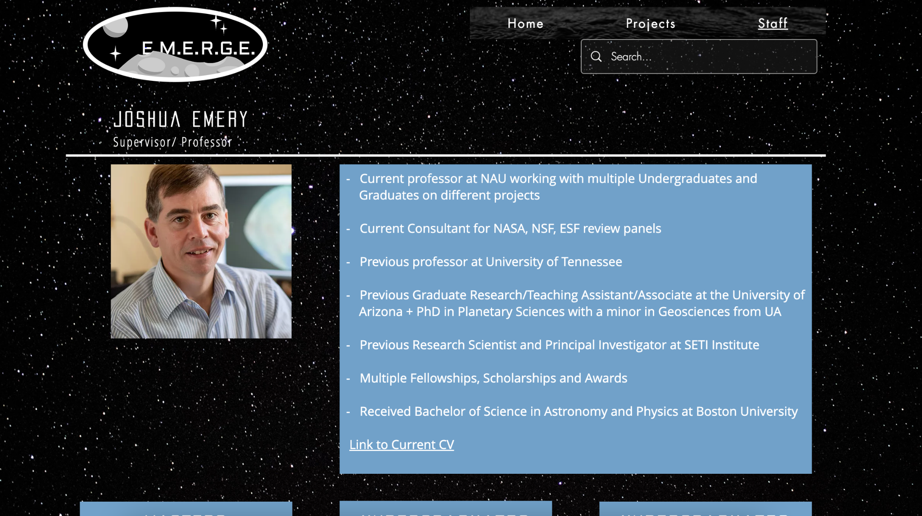
Website
Notes:
Beginning the website
EMERGE Staff including a list of all current and past students

Slide 8
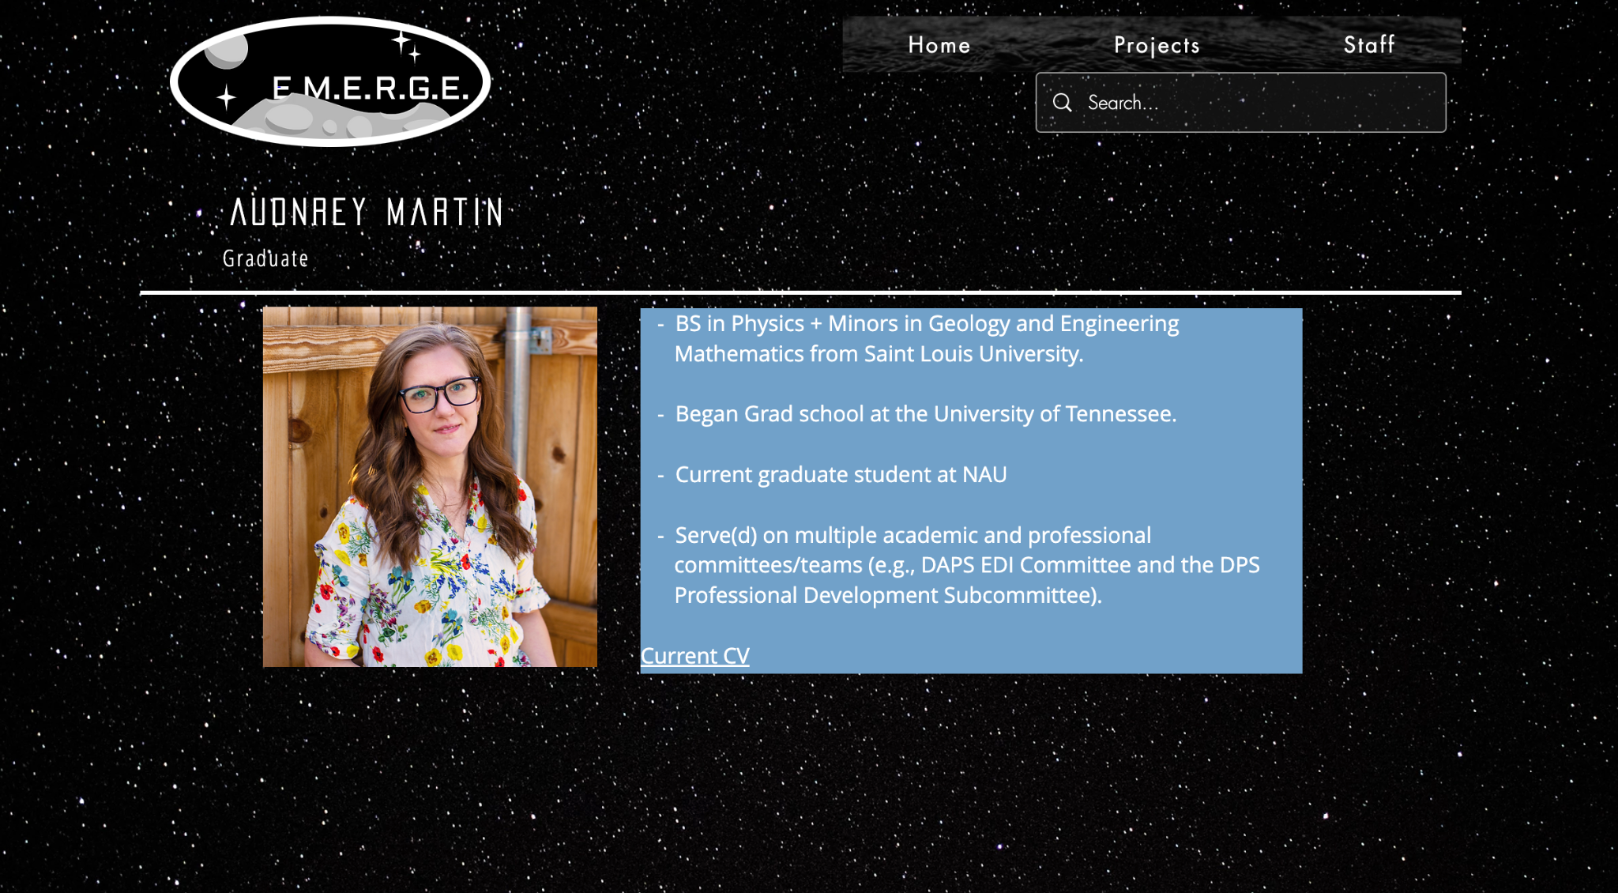
Website
Notes:
Beginning the website
Example: Audrey Martin, my mentor on this project

Slide 9
Goals
Create an engaging, easy to use Website.
2) Sustain a compelling Social Media account.
3) Find the best recipe for max engagement.
Notes:
Provide further details into project and make it easy for those who want to learn more
Make information interesting to viewers and digestible for all levels of astronomy knowledge
schedule, alternating captivating infographics and videos, utilizing hashtags, and posting at optimal times to maximize traction

Slide 10
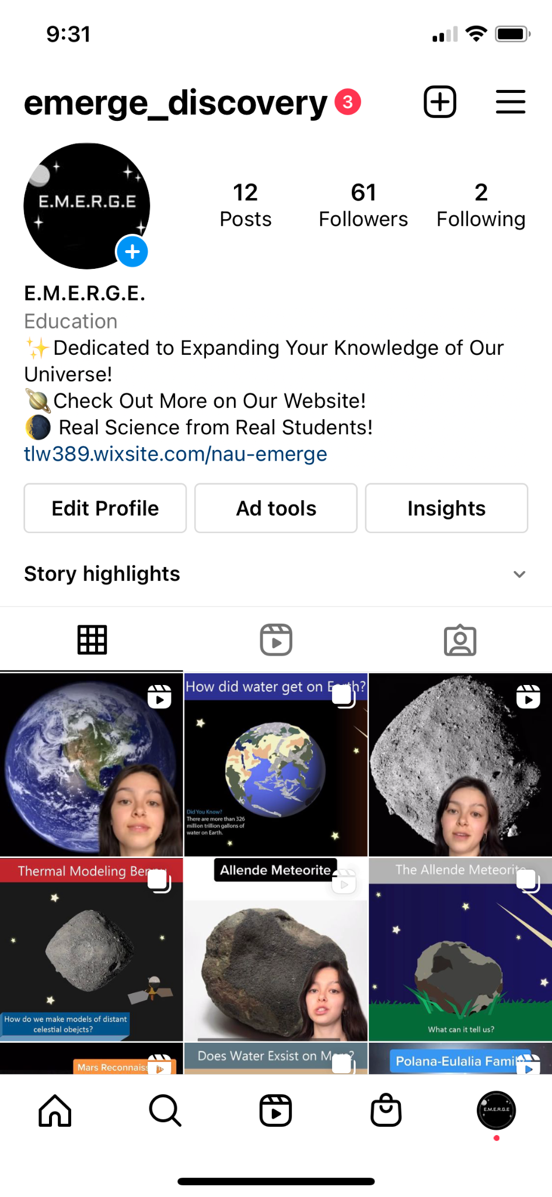
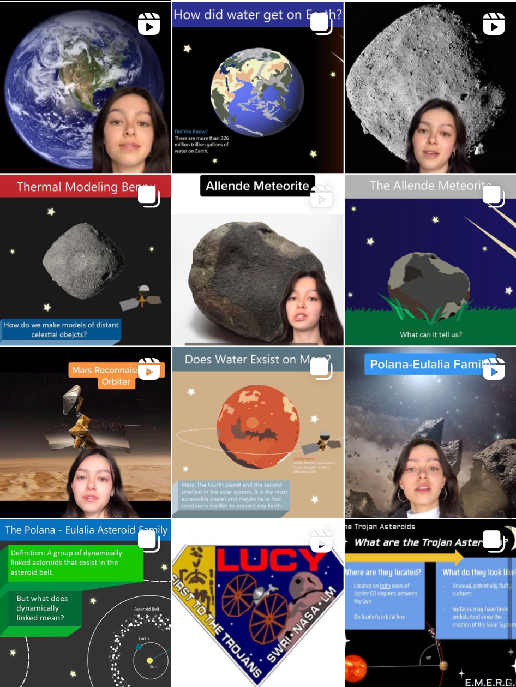
Instagram
Notes:
The Instagram account with both infographics and videos
Each essay has an associated infographic and video

Slide 11
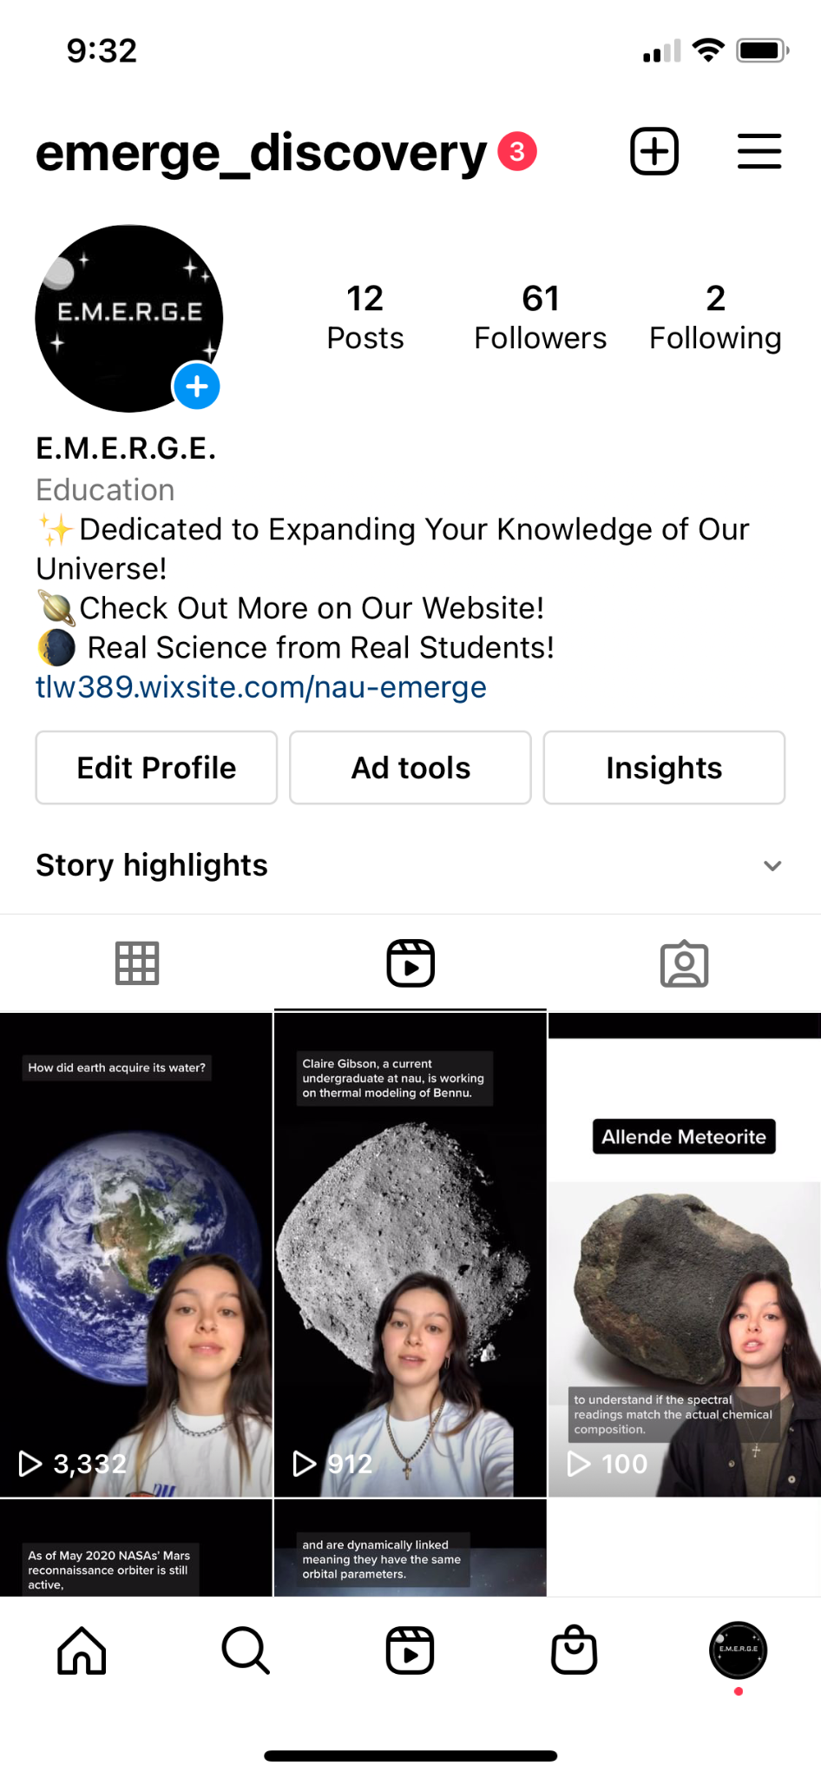
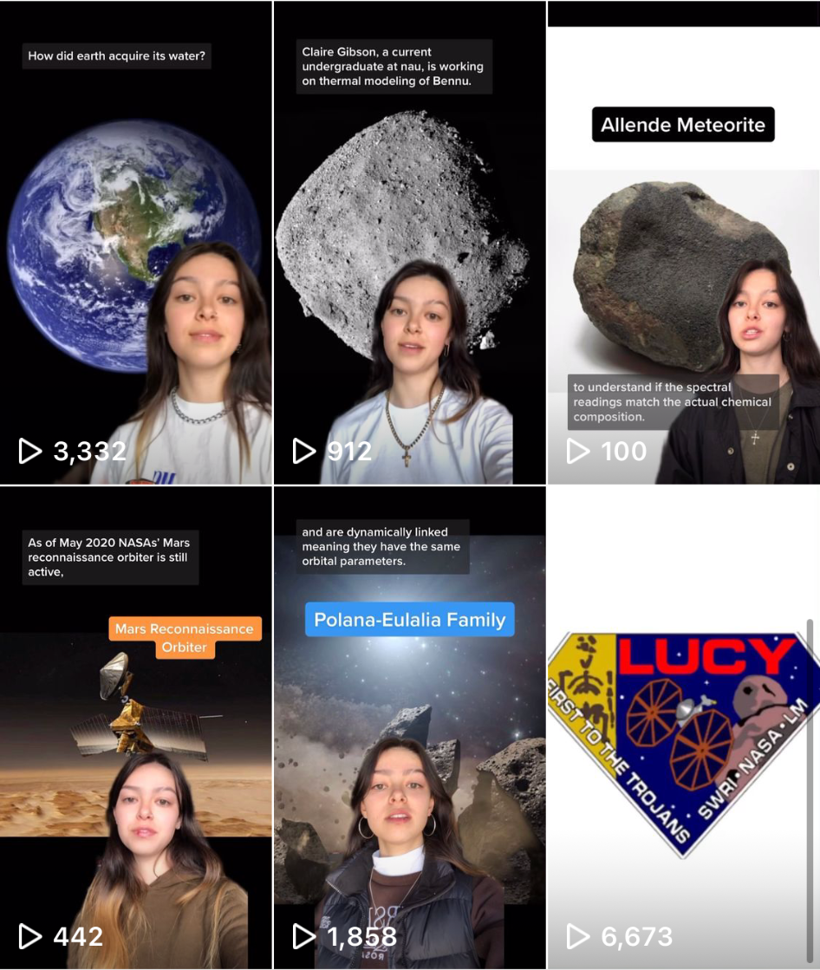
Instagram
Notes:
The videos on the account

Slide 12
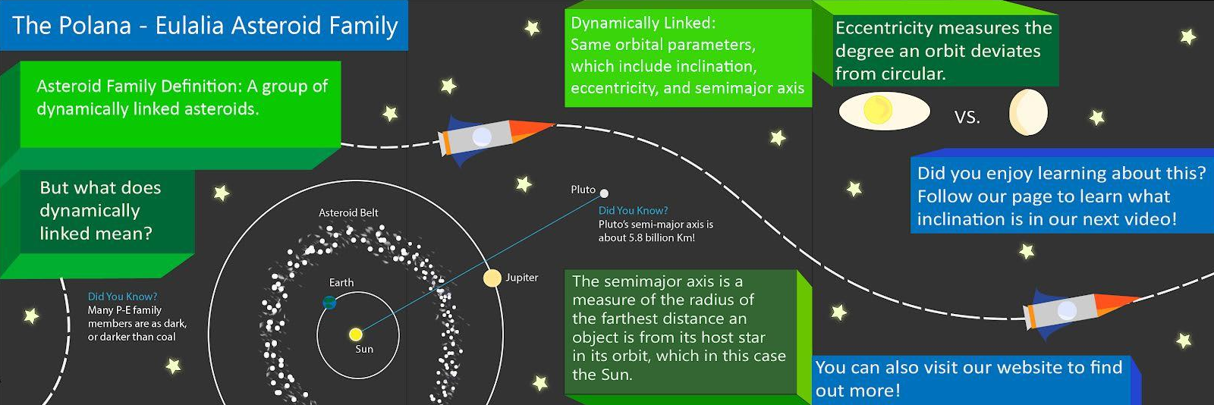
Instagram
Notes:
First infographic made with Illustrator

Slide 13
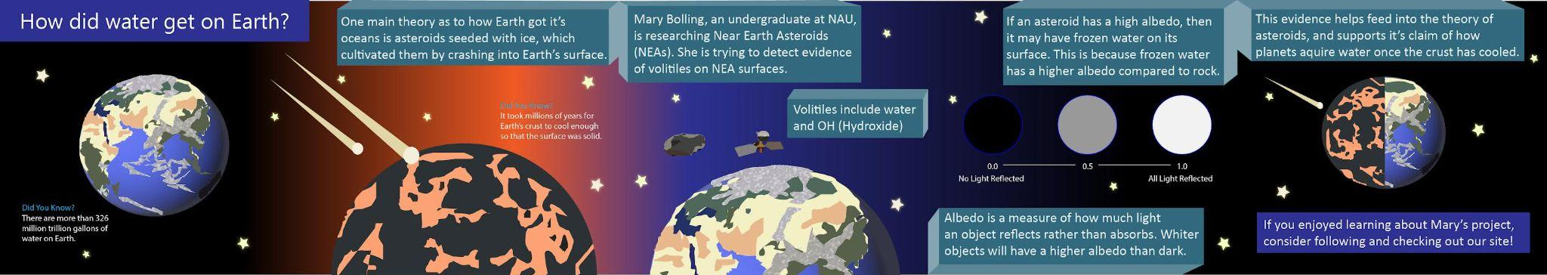
Instagram
Notes:
Most recent infographic
MAKE SURE TO UPDATE THIS

Slide 14
Goals
Create an engaging, easy to use Website.
2) Sustain a compelling Social Media account.
3) Find the best recipe for max engagement.
Notes:
Provide further details into project and make it easy for those who want to learn more
Make information interesting to viewers and digestible for all levels of astronomy knowledge
schedule, alternating captivating infographics and videos, utilizing hashtags, and posting at optimal times to maximize traction

Slide 15
Content Schedule
Week | Infographic Post | Video Post | Followers
Week 1 | Monday 12:00 pm | Friday 2:00 pm | 18
Week 2 | Thursday 12:00 pm | Friday 2:00 pm | 26
Week 3 | Tuesday 12:30 pm | Friday 2:00 pm | 31
Week 4 | Thursday 2:00 pm | Friday 2:00 pm | 35
Week 5 | Tuesday 12:00 pm | Monday 2:00 pm | 38
Week 6 | Monday 12:00 pm | Friday 2:00 pm | 50
Notes:
Aim is so get the max amount of traction on the video, because it is easier to get views and likes through videos than posts.

Slide 16
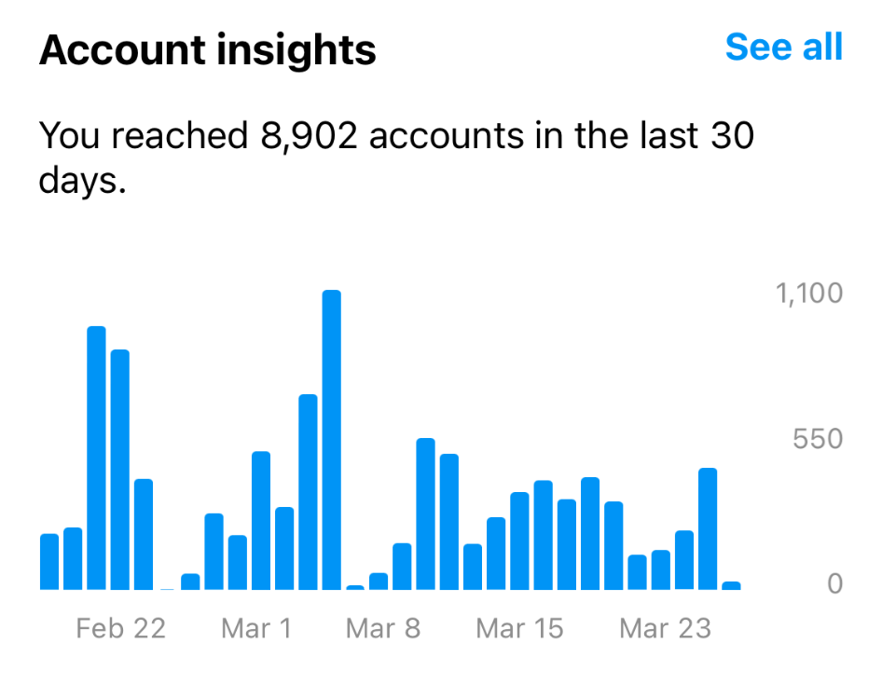
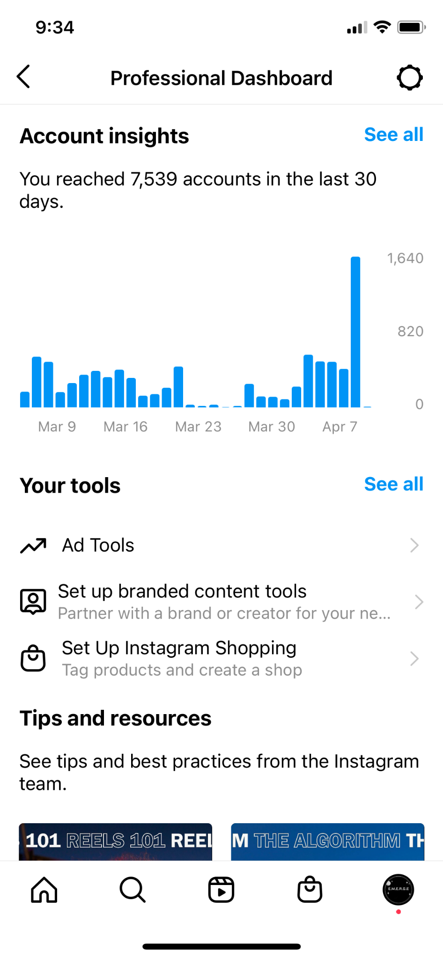
Content Schedule Conclusions

Slide 17
Hashtag Examples
#NASA
#Space
#Spacenews
#Spacefacts
#Astronomy
#AstronomyFacts
#LearnAstronomy
#Learn
#Education
#InterestingFacts
#Universe
Notes:
Hashtag examples on all posts, plus any relating hashtags to the topic. For example: “Does Water Exist on Mars?”
#MRO #mars #marsfacts #marsmission

Slide 18
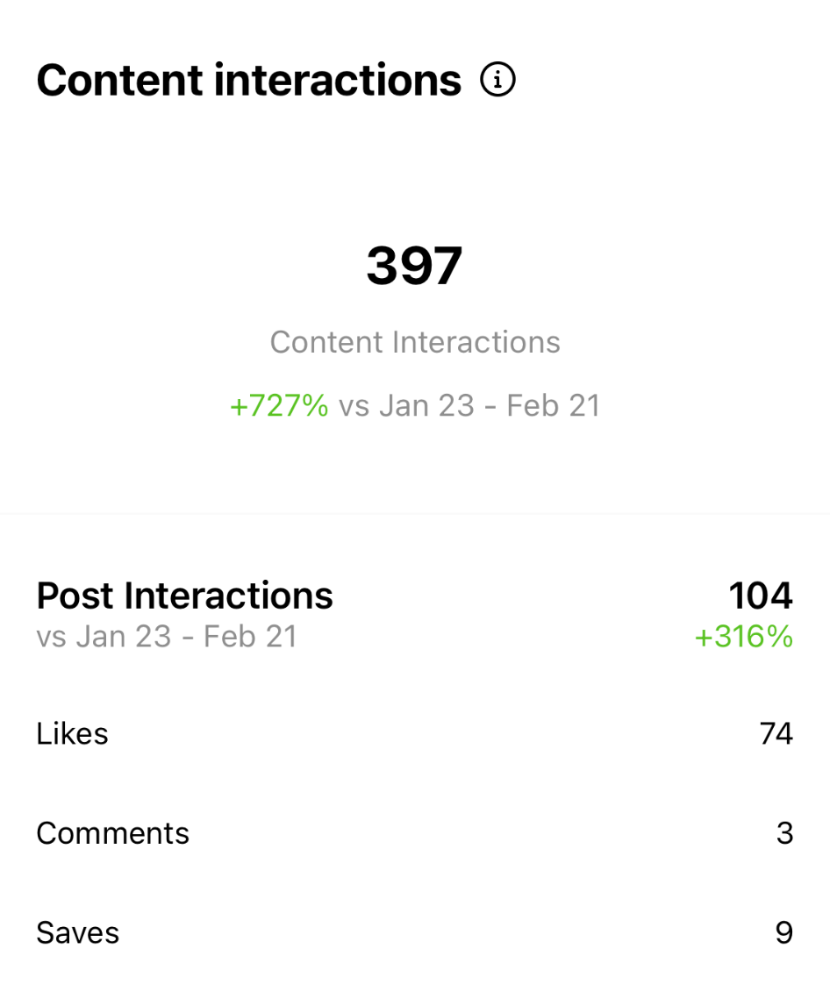
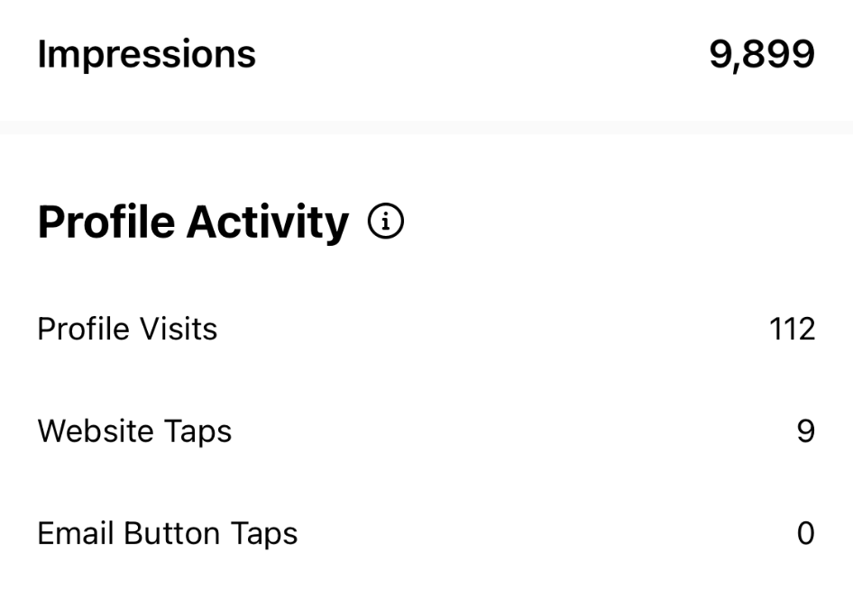
Content Schedule Conclusions

Slide 19
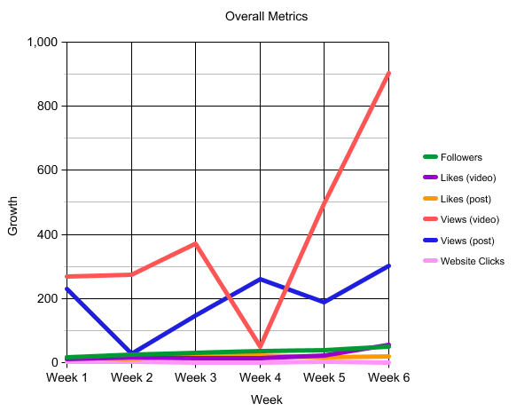
Overall Improvement
Most Viewed Video: 6,669
Most Viewed Post: 301
Total Followers: 61
Total website clicks: 10

Slide 20
Problem
Current Generation on Social Media
  50 Milliseconds
    Lindgaard et. al, 2011
  Attention

Slide 21
Question
How do you create a successful social media account and website for science information and news, and captivate the public?
Notes:
Public- mainly those who are active online and on social media (younger gen)

Slide 22
Conclusion
By sticking to a Monday/Friday schedule of infographic and video, we were able to maintain a gradual increase of followers.

Slide 23
Conclusion
We were unable to view our demographics due to our account being under 100 followers. In the future, that information will be accessible and can see, gender, age, region, and most active times.

Slide 24
Thank you!
Instagram Handle: @emerge_discovery
Link to Website in Instagram bio.
References
Gitte Lindgaard, Gary Fernandes, Cathy Dudek & J. Brown (2006) Attention web designers: You have 50 milliseconds to make a good first impression!, Behaviour & Information Technology, 25:2, 115-126, DOI: 10.1080/01449290500330448

